Slide 1

Lab 1
Team 5's
Group Members:
KUS AHMET BUGRA
LEE TENG YEE SHERILYN
LEE ZHENG JIE

Slide 2
Outline
Insertion, Merge & Hybrid Merge Sort Approach (Part a)
Experimental Results and Observations (Part b & c)
Optimal S Selection and Performance Analysis (Part c)
Compare with Original Merge Sort (Part d)
Conclusion and Key Takeaways

Slide 3
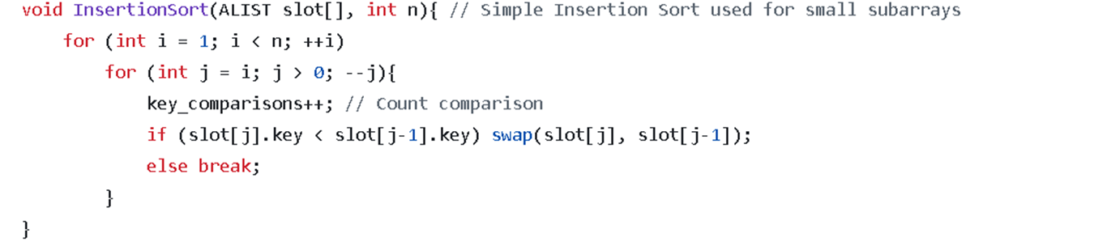
Insertion sort

Slide 4
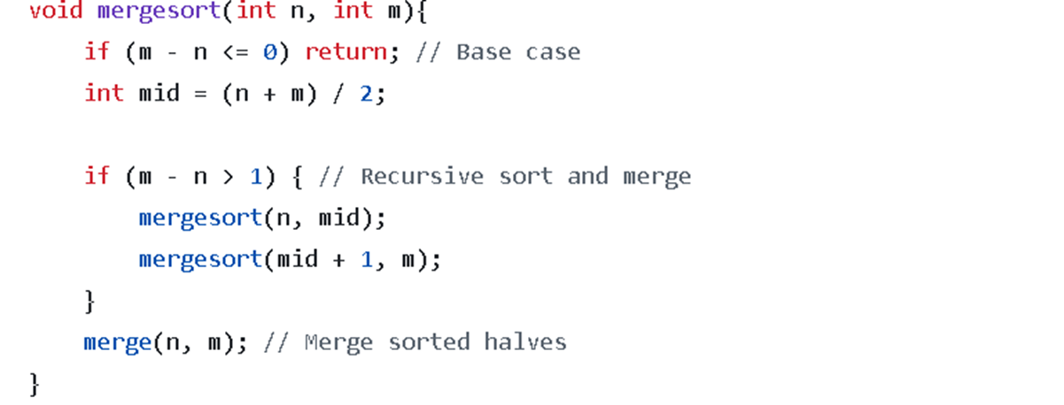

Merge sort

Slide 5
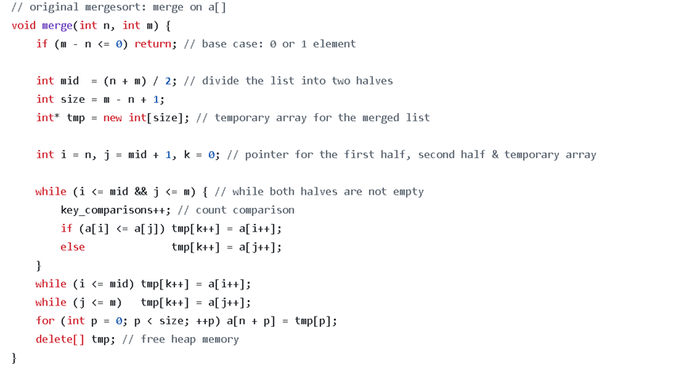

Merge sort

Slide 6
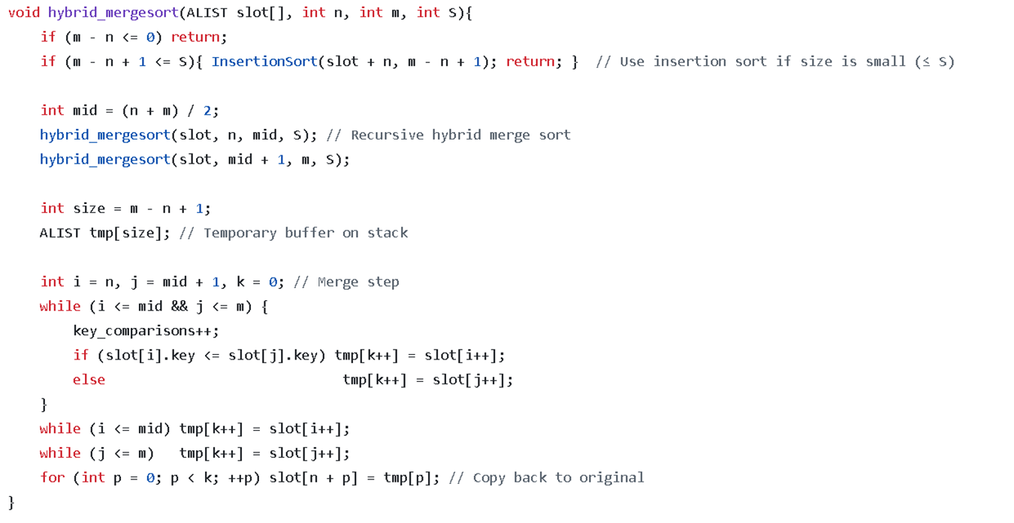
Hybrid sort
Notes:
No. Of Sub Arrays

Slide 7
Hybrid sort
Combines Merge Sort and Insertion Sort
Uses Insertion Sort for small subarrays (size ≤ S)
Reduces recursion overhead and improves cache performance
Overall faster in practice while keeping O(n log n) complexity

Slide 8
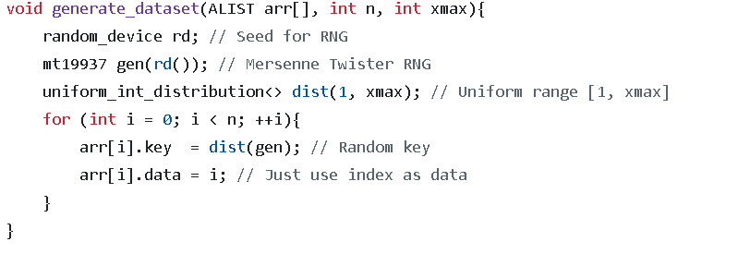
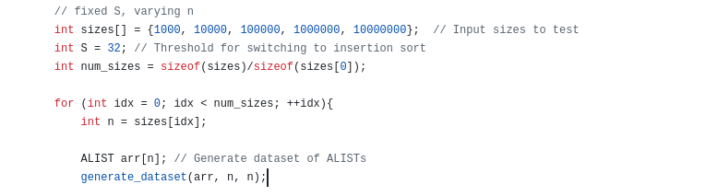
Generating input data

Slide 9
Time complexity
Algorithm | Best case | Worst case | Average case
Merge sort | O(n log n) | O(n log n) | O(n log n)
Insertion sort | O(n) | O(n^2) | O(n^2)
Hybrid | O(n log n) | O(n^2) | O(n log n)
Notes:
Explain briefly why the results are like that for all the algorithms, and all cases.

Slide 10
Key Comparisons vs. Input Size (Fixed S = 32)
Notes:
Y-axis is comparisons, x-axis is value of n. Shows overall growth trend.
The number of key comparisons increases roughly like O(n log n), which is what you’d expect for Merge Sort.
Since insertion sort is only used on small subarrays (size ≤ S), it does not dominate the asymptotic growth.
The slight dips and bumps (e.g., around 400k and 800k) happen because the threshold split sometimes reduces comparisons more efficiently than a pure merge.
If you compared this to pure Merge Sort, the hybrid should have slightly fewer comparisons (because insertion sort saves on overhead for small subproblems).
If you compared it to pure Insertion Sort, the hybrid should massively outperform at large sizes.
The graph you have indeed shows efficiency closer to Merge Sort but with some smoothing effects.

Slide 11
Theoretical logic (fixed s = 32)

Slide 12
Key Comparisons vs. S (fixed n)
Notes:
X-axis is S, y-axis is comparisons. Explain why there is the stairs.
The line is not smooth, but has plateaus and jumps.
This happens because S determines how deep the recursion goes before switching to insertion sort.
For many consecutive S values, the recursion tree structure is identical, so the total comparisons don’t change → plateau.
At some critical S, suddenly one more level of recursion switches from merge to insertion → big jump/drop in comparisons.
As S increases, you expect fewer recursive merges and more insertion sorts.
Since insertion sort is O(S²) on subproblems, setting S too high increases total comparisons → that’s why you see jumps upward at certain thresholds.
If S is too small, you basically get pure merge sort → high but stable comparisons.
Difference between N = 1M and N = 10M
The overall shape is the same (stairs), but the magnitude of comparisons is much larger for N = 10M.
The spacing of the “stairs” is wider at 10M, since deeper recursion = more sensitive to S
Conclusion:
They show the structural effect of the S threshold in hybrid sort.
The “step function” is expected, because only certain S values actually change how many times insertion sort is applied.

Slide 13
Key Comparisons vs. S (fixed n)
Notes:
X-axis is S, y-axis is comparisons. Add one more graph at n=1000. Explain why there is the stairs.
The line is not smooth, but has plateaus and jumps.
This happens because S determines how deep the recursion goes before switching to insertion sort.
For many consecutive S values, the recursion tree structure is identical, so the total comparisons don’t change → plateau.
At some critical S, suddenly one more level of recursion switches from merge to insertion → big jump/drop in comparisons.
As S increases, you expect fewer recursive merges and more insertion sorts.
Since insertion sort is O(S²) on subproblems, setting S too high increases total comparisons → that’s why you see jumps upward at certain thresholds.
If S is too small, you basically get pure merge sort → high but stable comparisons.
Difference between N = 1M and N = 10M
The overall shape is the same (stairs), but the magnitude of comparisons is much larger for N = 10M.
The spacing of the “stairs” is wider at 10M, since deeper recursion = more sensitive to S
Conclusion:
They show the structural effect of the S threshold in hybrid sort.
The “step function” is expected, because only certain S values actually change how many times insertion sort is applied.

Slide 14
Key Comparisons vs. S (fixed n)

Slide 15
Time Comparisons vs. S (fixed n)
Mergesort time completion: ≈ O(nlog(n/S)), fewer merges as S grows.
Insertion time completion: ≈ O(nS), dominates for large S.
Overall: Comparisons drop then rise → optimal S minimizes total cost.

Slide 16
Optimal S
How did we determine?
Did multiple trial runs and compared the time. We select the S that has the fastest and consistent time to run the code
N Input | Optimal S
1,000 | 28
1,000,000 | 40
10,000,000 | 32
Notes:
How do we determine: Trial and error to find the n

Slide 17
Timing over Fixed value of S = 32
Notes:
Fix value of S at 32. try to guess what its supposed to be like, then compare with the actual data from graph. Bring up some hypothesis.

Slide 18
Comparing key comparisons, S=32
Notes:
X-axis is value of n. y-axis is the comparisons.

Slide 19
Comparing of performances
CPU time was lower for the hybrid algorithm, resulting in faster execution.
Mergesort has fewer key comparisons
Performance gap became more significant as input size increased.
Time complexities are close, but insertion sort slightly outperforms merge sort for small input sizes.
This shows our hybrid is much more efficient than the merge sort, especially for larger N inputs

Slide 20
Issues faced
Our initial code implementation had faced the issue of the hybrid algorithm taking a longer time than the merge algorithm. This is identified to be caused by the stack structure, where at large sizes, it uses RAM a lot.
The internet doesn’t explain how we would determine the optimal S
We had troubles trying to show the process of determine the optimal S
Optimal S constantly changes after repeated runs
We had troubles trying to show how long it took to run the sort

Slide 21
THANK YOU

